Slide 1
Art + Tech
The Beauty of Design

Slide 2
Beauty
https://www.youtube.com/watch?v=oaUY8bU5XBI
https://www.youtube.com/watch?v=ga994lIm96A
https://www.youtube.com/watch?v=OkHGUaB1Bs8

Slide 3
What is beauty in this context?
Are there rules?

Slide 4
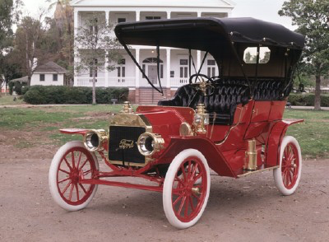
Why can design be beautiful?
Creative
An object or body of work that didn’t exist before

Slide 5
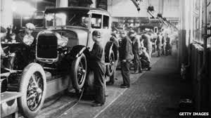
Why can design be beautiful?
Creative
An object or body of work that didn’t exist before
Sometimes a set of rules that didn’t exist before

Slide 6
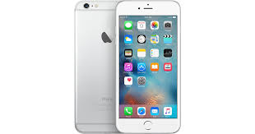
Why can design be beautiful?
Elegant
Can express the solution to a complex need clearly and concisely

Slide 7
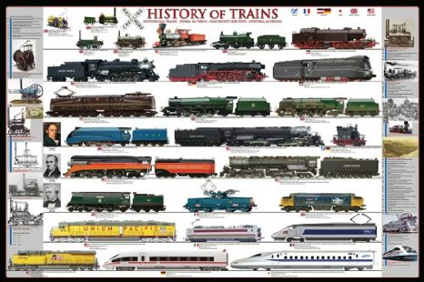
Why can design be beautiful?
Evolving
Often iterative improvement

Slide 8
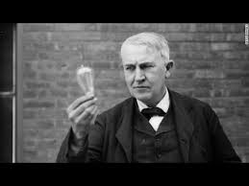
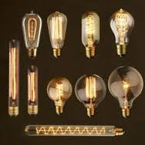
Why can design be beautiful?
Evolving
Often iterative improvement

Slide 9

Why can design be beautiful?
Evolving
Can be super- iterative improvement

Slide 10

Why can design be beautiful?
Cooperative
Can require the collaborative efforts of a diverse set of people

Slide 11
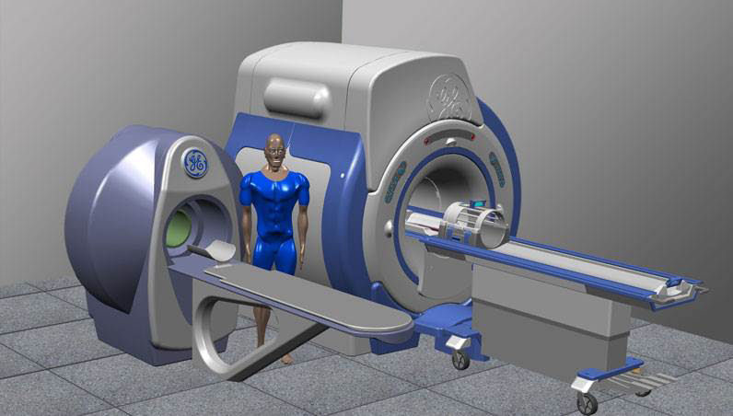
Why can design be beautiful?
(Can be) Original way of doing things

Slide 12
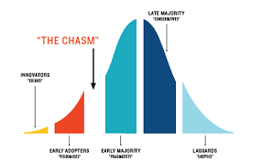
Why can design be beautiful?
(Can be) Original way of doing things
Measurable

Slide 13
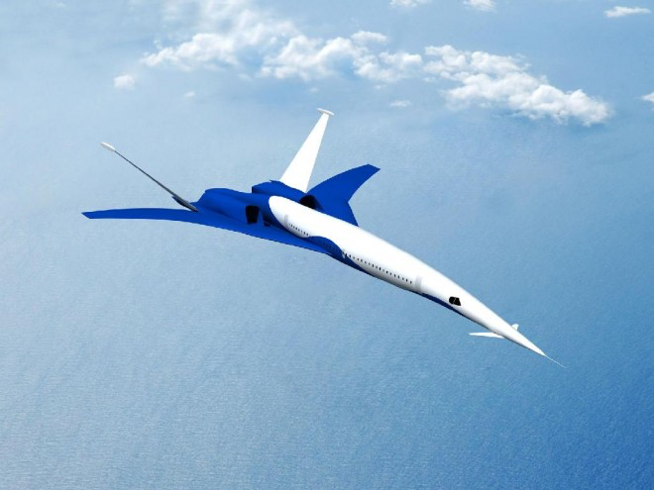
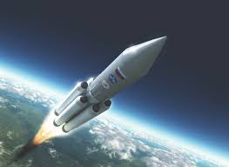
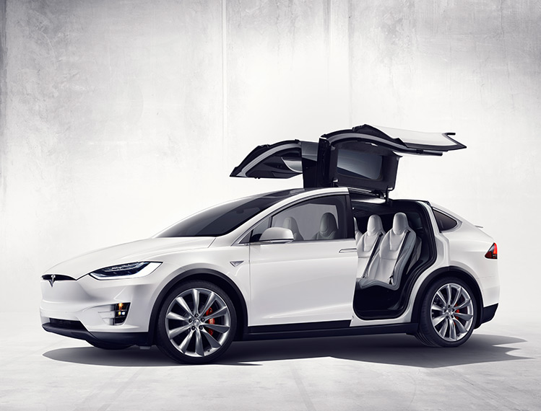
Fighting air helps

Slide 14
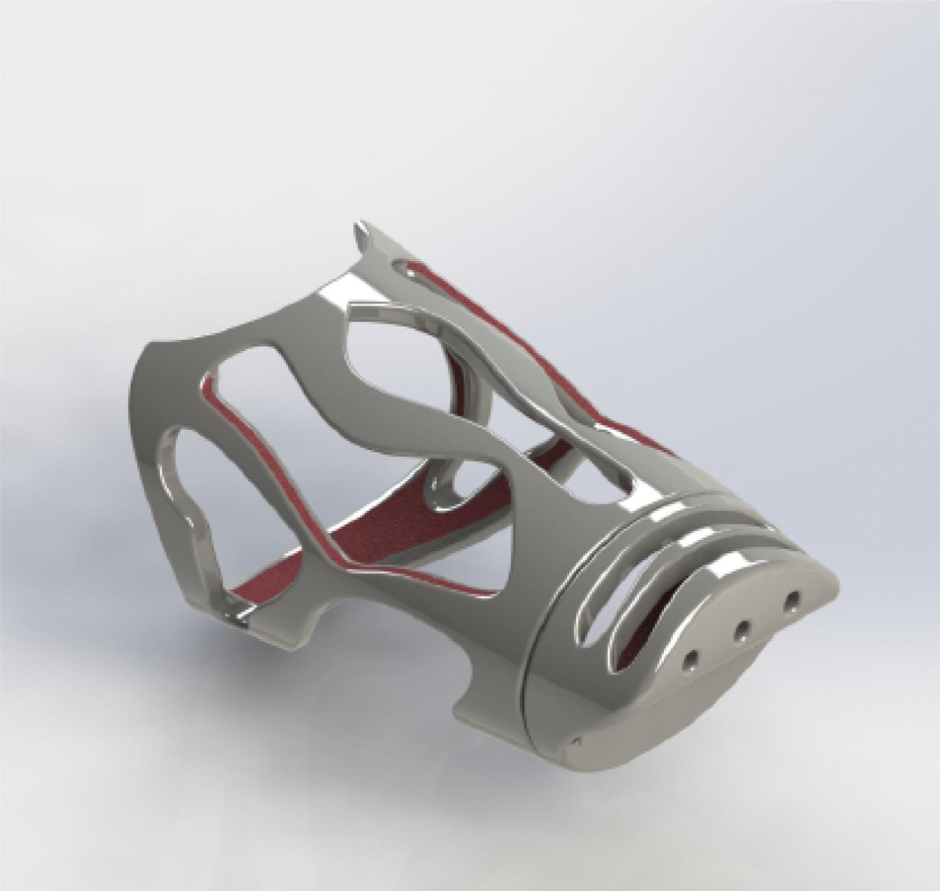
Some Caltech examples. . .
Castality forearm prostheses

Slide 15
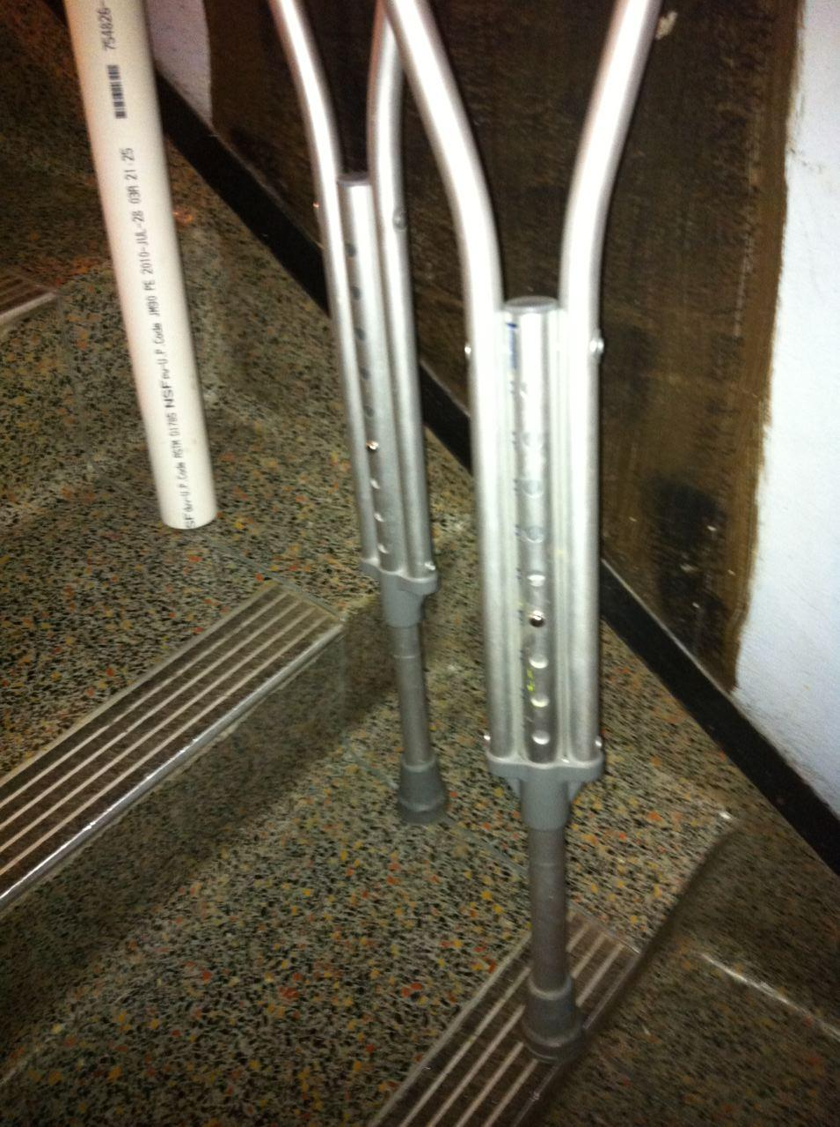
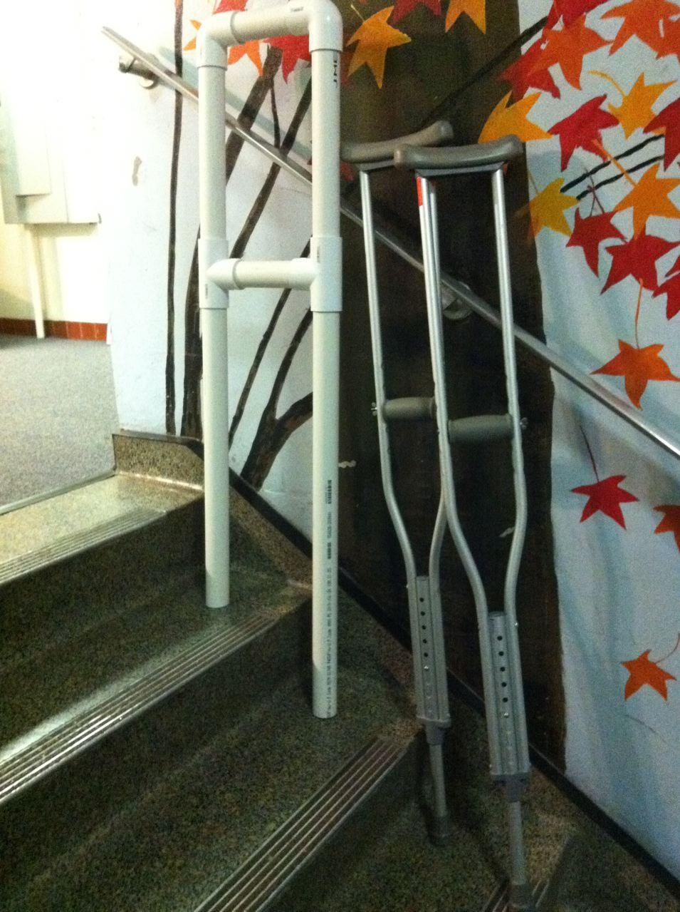
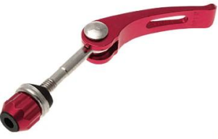
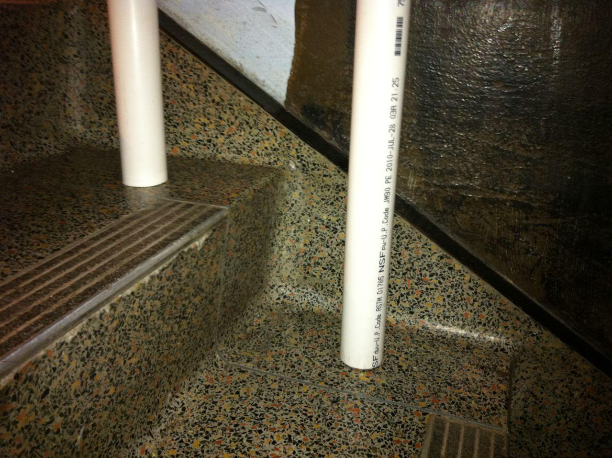
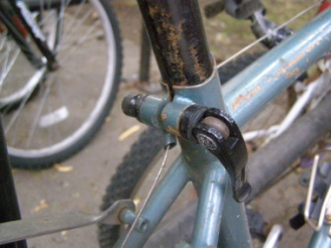
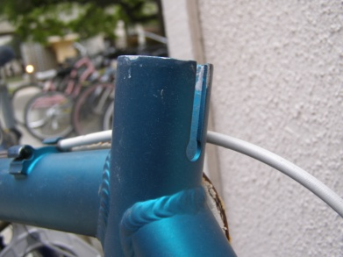
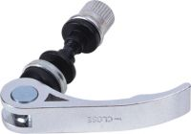
Crutches for stairs in Guatemala
Integral design
Single static piece
Foam, not rubber, arm rest
Easily adjustable
4 points of contact
Easy to Manufacture
Weldable Steel Pipe
Aluminum Pipe
15

Slide 16
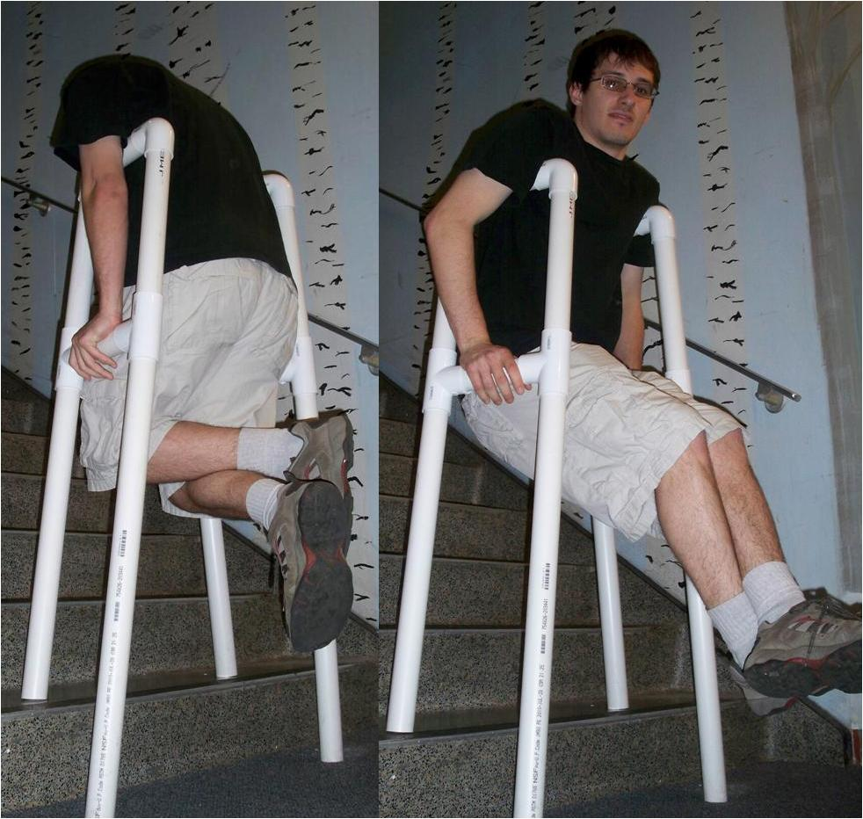
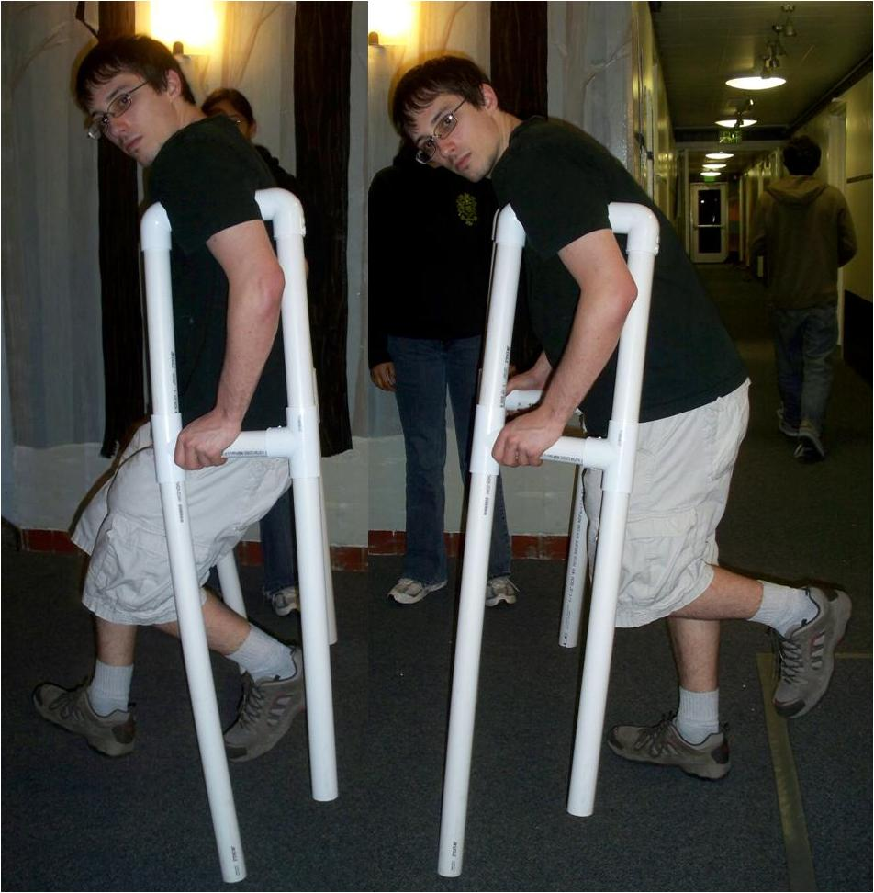
Stair climbing crutches

Slide 17

Wheelchair

Slide 19
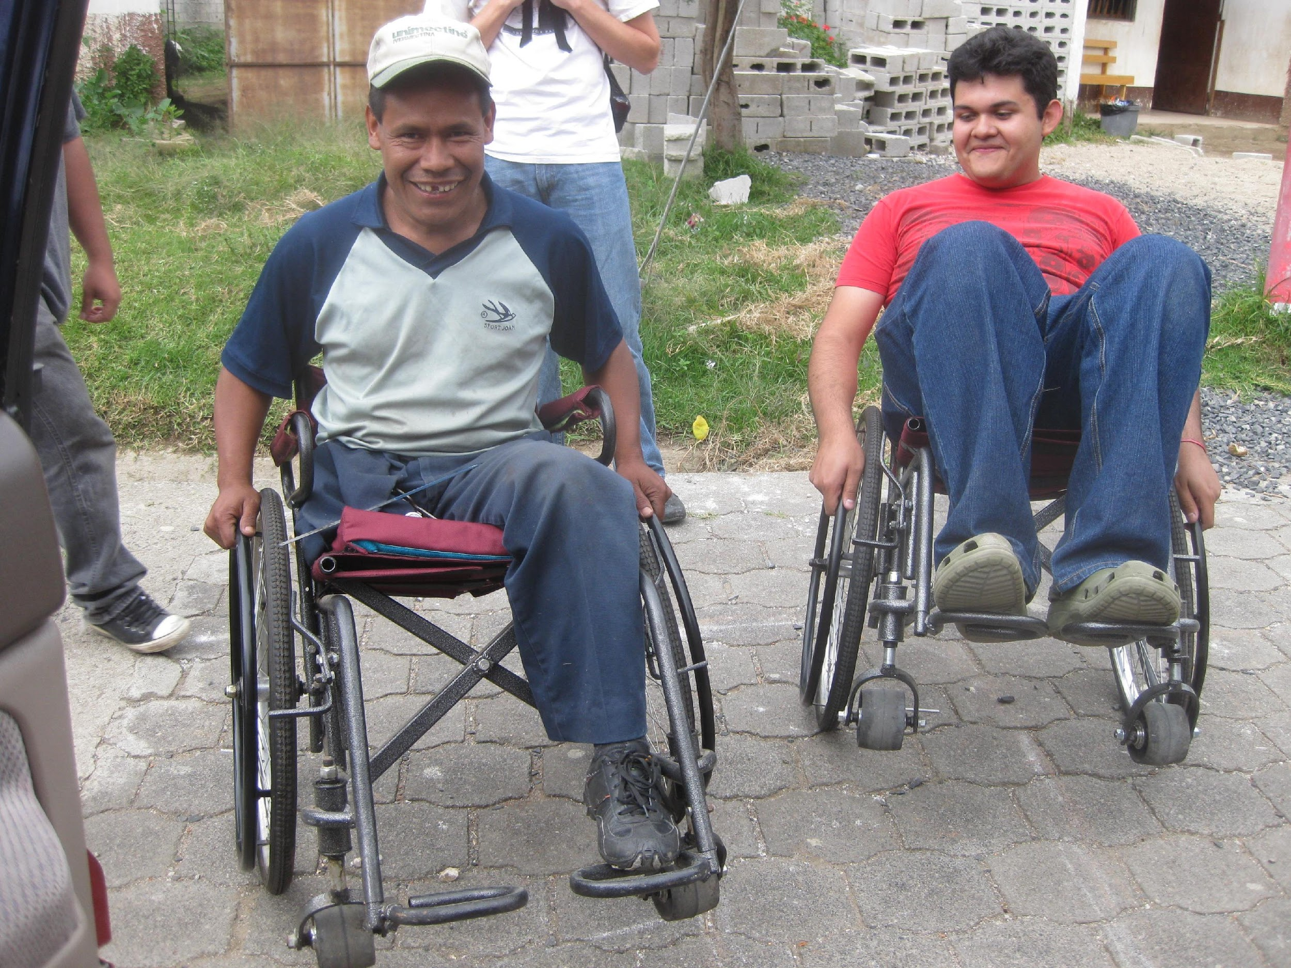

IMI Wheelchair
Made from Bicycle parts
300 Distributed in Guatemala through partnership

Slide 20
Some “Great” ideas now being worked on
Hemiplegic Wheelchair
Door opener
Charging electric wheelchair
Carry ons
Anti-shake pen
Pressure pad

Slide 21
It’s not all beautiful. . .
Bad Design equals Bad Art
Hurt the user
Hard to use
Use is obscure
Overly complex
Pleases designer and no one else

Slide 22
Question
What is the most beautiful product you ever used?

